Slide 1



Lessor portfolios through the lens of Impact framework

Slide 2

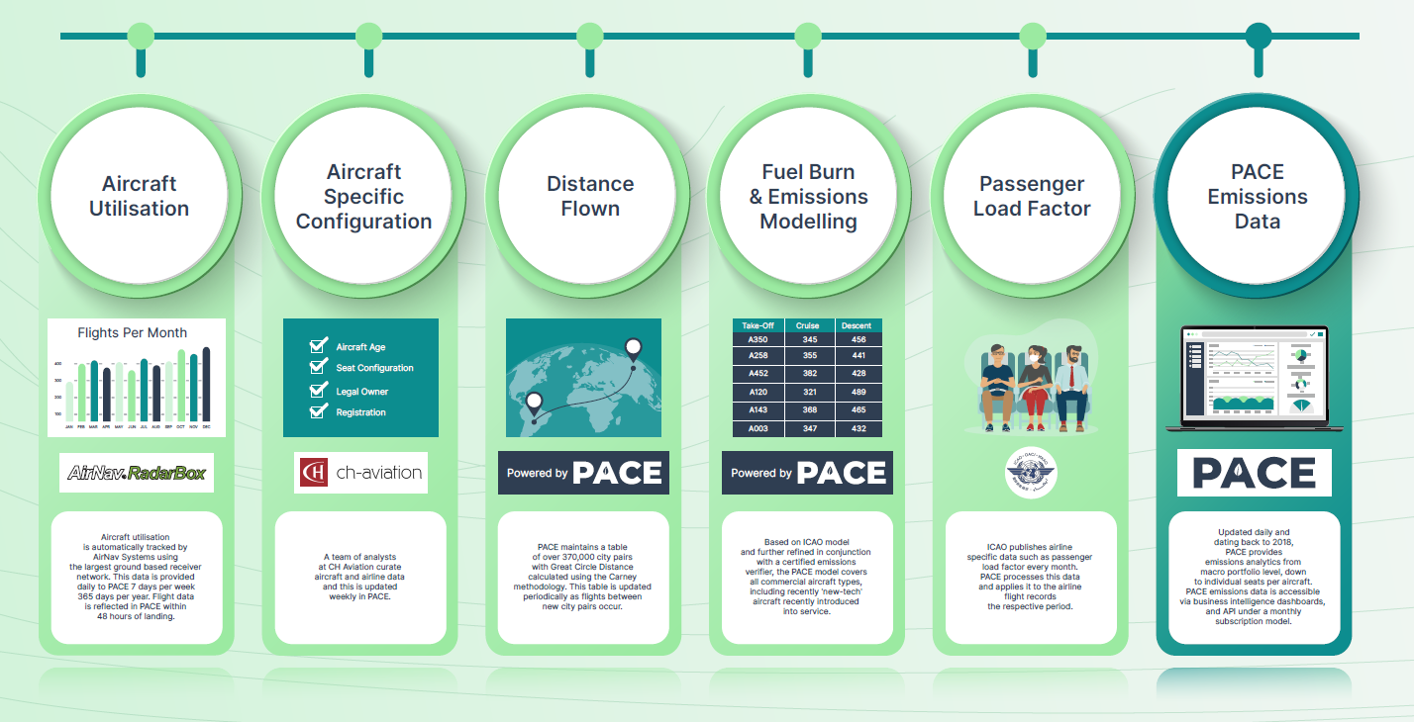
PACE Methodology

Slide 3

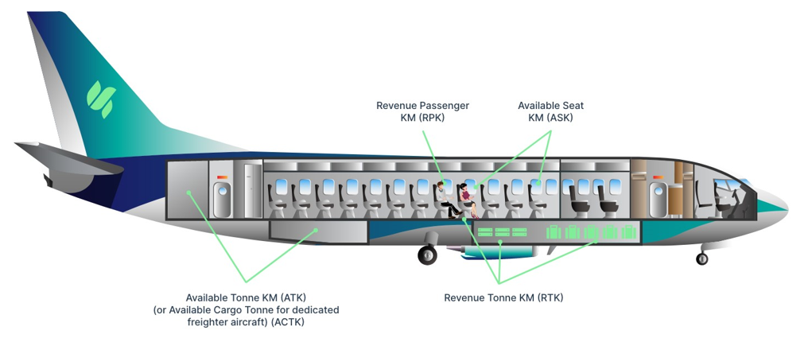
PACE Platform
‘Fleet to Seat’ Analysis
From Airline Group down to cargo consignments, using actual utilisation and load factor data.
Full Spectrum of Intensity Metrics
To enable carbon analysis specific to the business model of each airline.
Global coverage
All commercial flights & aircraft types, with no dependency on airlines to provide data.
Aligned with Leading Frameworks
Easy application of Pegasus Principles or Impact lens without manual data manipulation.

Slide 4
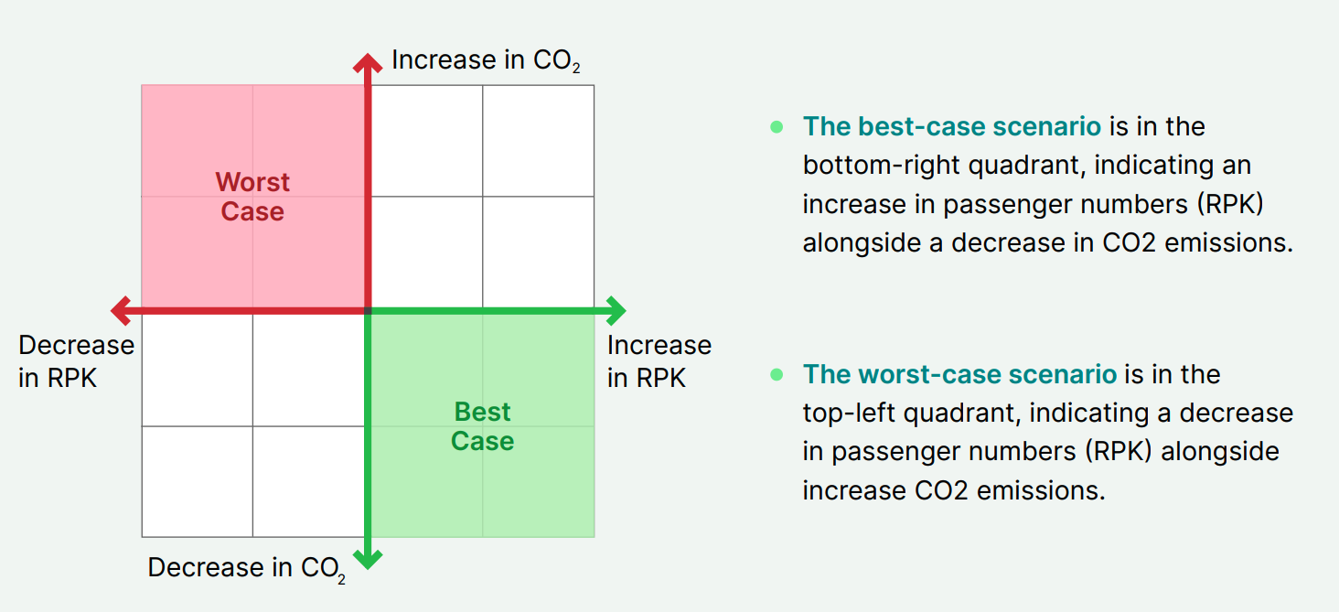
Impact Framework
The Impact framework is used to evaluate airline reported emissions against passenger capacity metrics measured here in Revenue Passenger Kilometers (RPK). The variance of these metrics against a baseline year is called “de-coupling’. Each year the level of decoupling can be scored against a pre-defined matrix.
Relative decoupling
Whether total emissions are growing slower than their associated capacity
Absolute decoupling
Whether total emissions are declining as capacity grows
(the ultimate objective).
-3
-2
-1
0
-2
-1
0
1
-1
0
1
2
0
1
2
3

Slide 5

Analysis of nine lessor portfolios since 2020

Slide 6


Analysis of nine lessor portfolios since 2020
Nine lessors analysed: AerCap, Aircastle, Aviation Capital Group, Avolon, CALC, DAE, Jackson Square Aviation, Orix Aviation, and SMBC Aviation Capital
Owned fleet in each reporting year, fleet data from CH Aviation
Emissions baseline year: 2019
Analysed period: 2020 to 2023
Emissions reduction methodology: Impact’s decoupling metric and decoupling-based milestones
Full report available on Ishka SAVi:
AerCap and SMBC Aviation Capital include the portfolios of GECAS and Goshawk

Slide 7
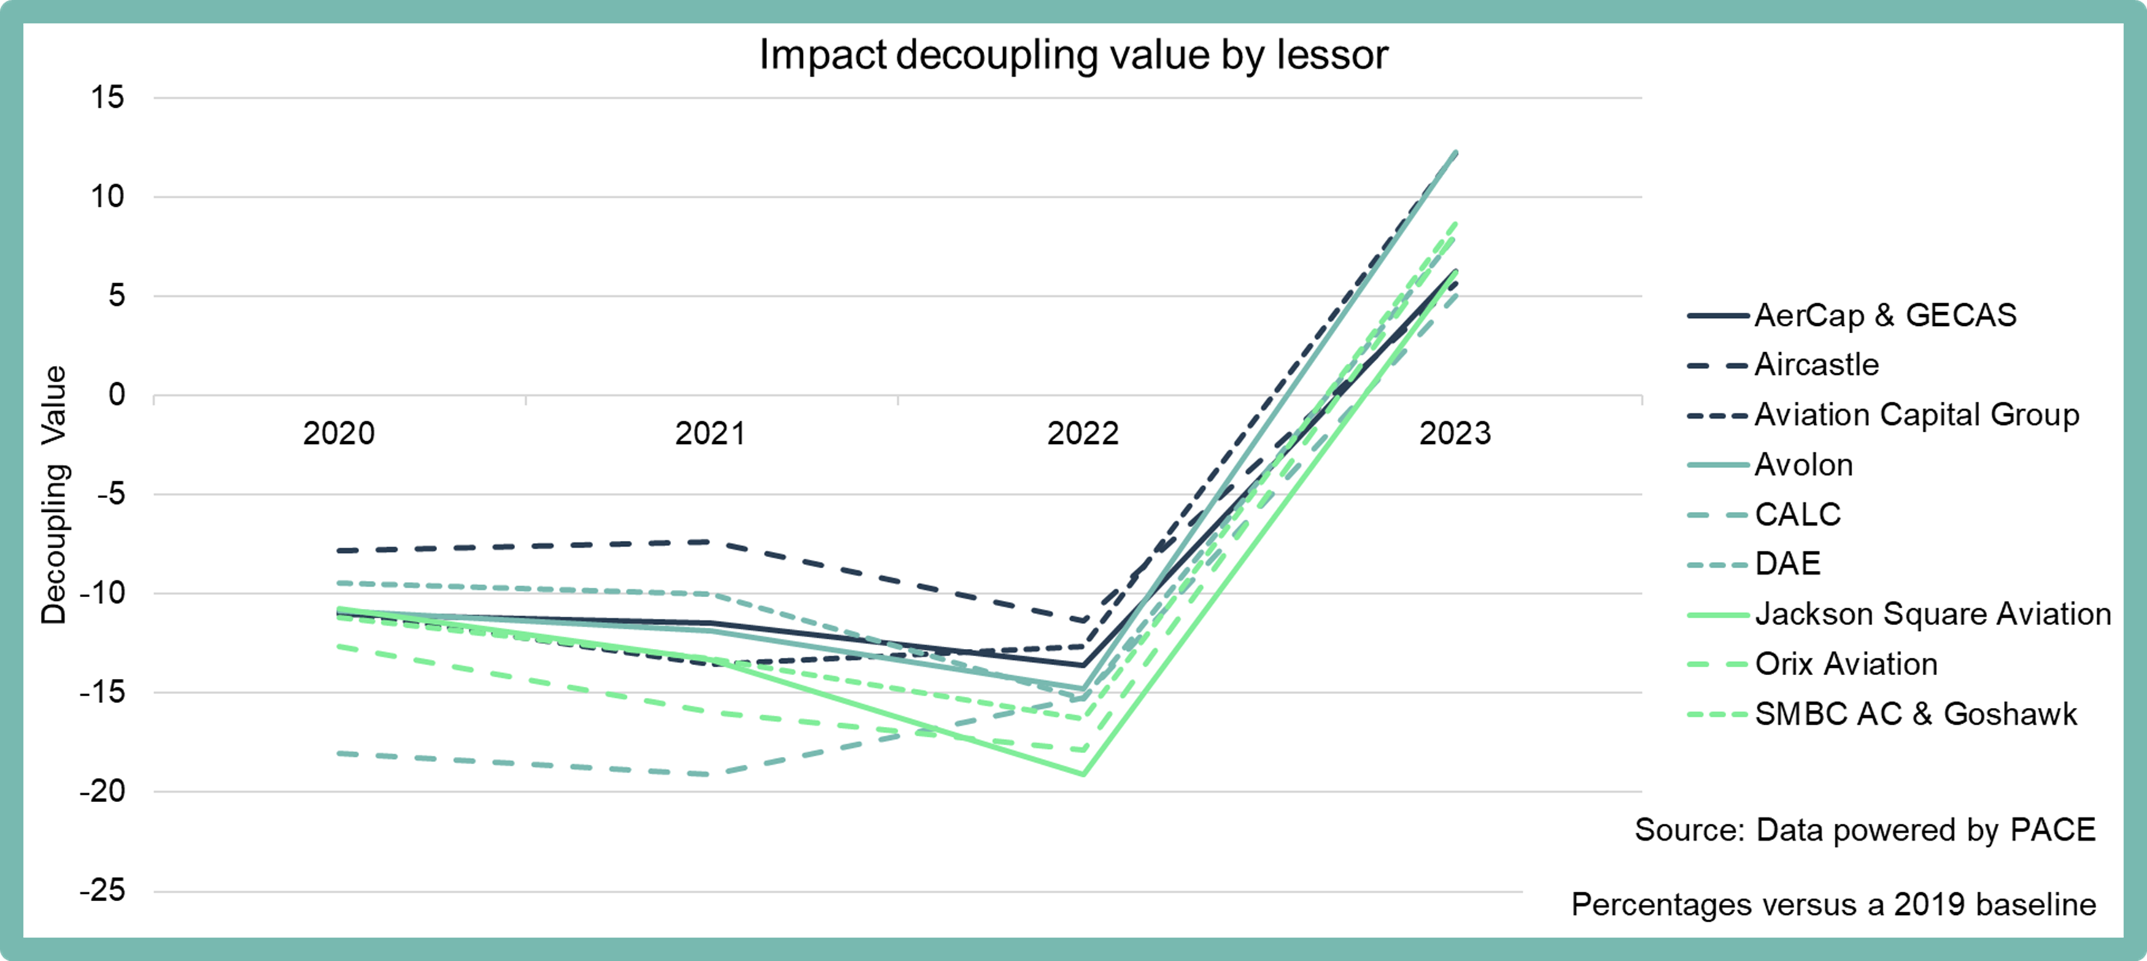
Positive decoupling achieved in 2023
The decoupling value expresses the percentage change difference between RPK and absolute CO2 emissions versus a 2019 baseline.
In 2023, all analysed lessors achieved positive decoupling
Most achieved relative decoupling: aircraft in their portfolios grew traffic (revenue per passenger kilometre) faster than they grew absolute emissions.

Slide 8
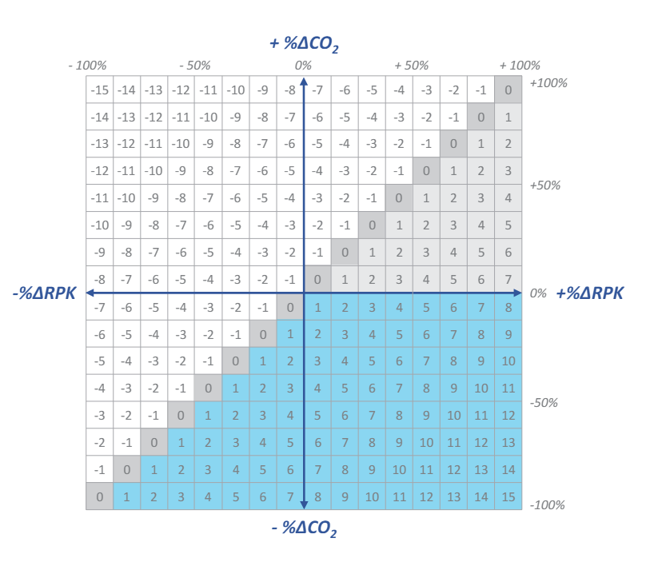
Scores between 0 and 1 in 2023
All lessors achieved decoupling in 2023 versus 2019, with decoupling values between 5 and 12 percentage points
Most achieved relative decoupling (light grey quadrants)
Two lessors (Orix and Aircastle) achieved absolute decoupling whereby absolute CO2 also declined vs 2019 (light blue quadrants).
Fleet renewal and upgauging have limitations. SAF and other measures needed to move faster.

Slide 9
Q & A

